Slide 1
Computer Architecture Experiment
Topic 2. 5-stage CPU executing in pipeline & Pipelined CPU with stall
浙江大学计算机学院
陈文智
chenwz@zju.edu.cn

Slide 2
实验操作流程
阅读实验文档，理解处理器的各个功能模块组成和内部实现方式。
补全各个功能模块源代码中的空缺部分。
对处理器进行仿真，检验处理器的仿真结果是否符合要求。
综合工程并下载至开发板，在单步执行的过程中检查调试屏幕的输出，检验处理器的执行过程是否正确。

Slide 3
实验验收标准
仿真执行过程中，处理器的行为和内部控制信号均符合要求。
下载至开发板后的单步执行过程中，寄存器的变化过程和最终执行结果与测试程序相吻合。

Slide 4
Outline
Experiment Purpose
Experiment Task
Basic Principle
Operating Procedures
Precaution
Checkpoints

Slide 5
Experiment Purpose
Understand the principles of Pipelined CPU
Understand the basic units of Pipelined CPU
Understand the working flow of 5-stages
Understand the principles of Pipelined CPU Stall
Understand the principles of Data hazard
Master the method of Pipelined CPU Stalls Detection and Stall the Pipeline.
Master simulation of CPU Cores modules
master methods of program verification of Pipelined CPU with Stall

Slide 6
Experiment Task
Design the CPU Controller
Based on the CPU Controller, Design the Datapath of 5-stages Pipelined CPU
5 Stages
Register File
Memory (Instruction and Data)
other basic units
Design the Stall Part of Datapath of 5-stages Pipelined CPU
Adding Condition Detection of Stall
Simulating CPU Core module
Verify the Pp. CPU with program and observe the execution of program

Slide 7
Comparison of three CPUs’ work

Slide 8
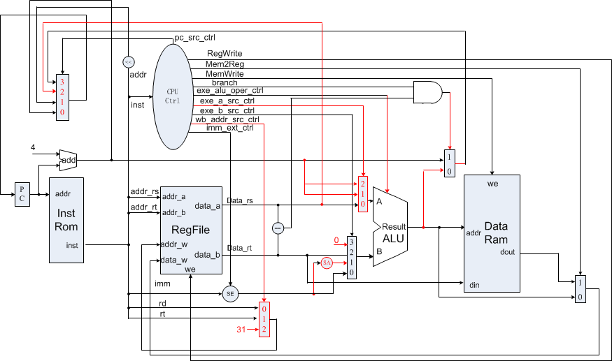
The principle of Single-cycle CPU

Slide 9
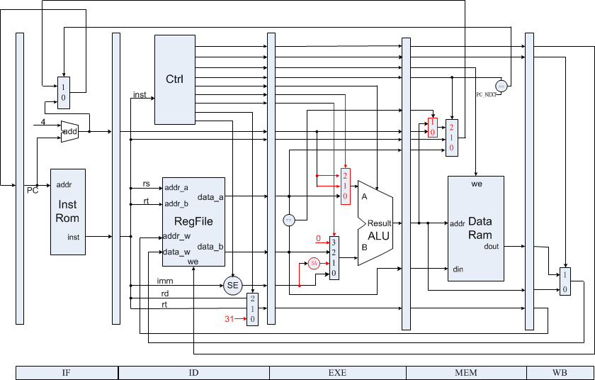
Datapath of 5-stages Pipelined CPU

Slide 10
Structural hazards －resource conflicts
Structural hazards arise from resource conﬂicts when the hardware cannot support all possible combinations of instructions in simultaneous overlapped execution.
Memory conflicts
Register File conflicts
Other units conflicts

Slide 11
How to resolve Structural hazards

Slide 12
Memory
Instruction Memory
Single Port Mem.
Read only, Width:32, Depth: 64
Falling Edge Triggered
Data Memory
Single Port Mem.
Read and write, Width:32, Depth: 32
Falling Edge Triggered

Slide 13
Instruction Memory
parameter
ADDR_WIDTH = 6;
reg [31:0] data [0:(1<<ADDR_WIDTH)-1];
initial begin
$readmemh("inst_mem.hex", data);
end
reg [31:0] out;
always @(negedge clk) begin
out <= data[addr[ADDR_WIDTH-1:0]];
end
always @(*) begin
if (addr[31:ADDR_WIDTH] != 0)
dout = 32'h0;
else
dout = out;
end

Slide 14
Data Memory(1)
parameter
ADDR_WIDTH = 5;
reg [31:0] data [0:(1<<ADDR_WIDTH)-1];
initial begin
$readmemh("data_mem.hex", data);
end
always @(negedge clk) begin
if (we && addr[31:ADDR_WIDTH]==0)
data[addr[ADDR_WIDTH-1:0]] <= din;
end

Slide 15
Data Memory(2)
reg [31:0] out;
always @(negedge clk) begin
out <= data[addr[ADDR_WIDTH-1:0]];
end
always @(*) begin
if (addr[31:ADDR_WIDTH] != 0)
dout = 32'h0;
else
dout = out;
end

Slide 16
Register File
negative edge for write operation
read operation at any time
Double Bump

Slide 17
Register File
reg [31:0] regfile [1:31]; // $zero is always zero
// write
always @(negedge clk) begin
if (en_w && addr_w != 0)
regfile[addr_w] <= data_w;
end
// read
always @(*) begin
data_a = addr_a == 0 ? 0 : regfile[addr_a];
data_b = addr_b == 0 ? 0 : regfile[addr_b];
end
// debug
`ifdef DEBUG
always @(*) begin
debug_data = debug_addr == 0 ? 0 : regfile[debug_addr];
end
`endif

Slide 18
Timing for Pipelined CPU
Positive Edge: State Transfer
Negative Edge
Instruction Mem. Read
Data Mem. Read/Write
Regfile Write
Regfile Read: anytime

Slide 19
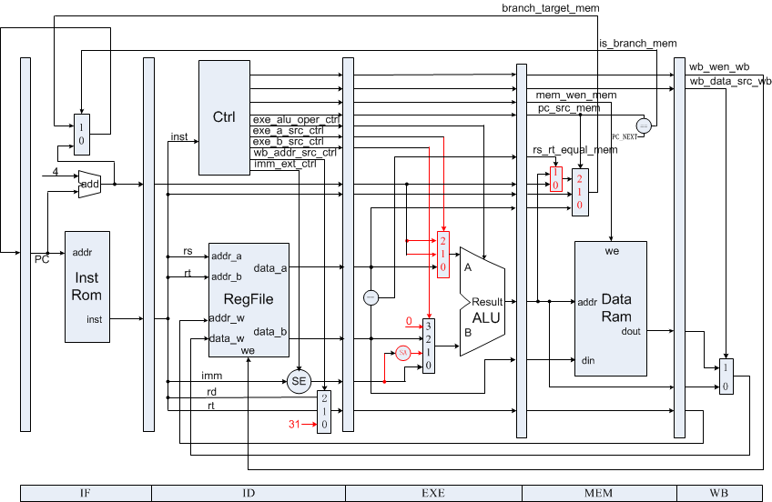
The principle of Pipelined CPU

Slide 20
Data Hazard Definition
Data Hazards arise when an instruction depends on the results of a previous instruction in a way that is exposed by the overlapping of instructions in the pipeline.
When inst. i executes before instr. j, there are data hazards:
RAW, i.e. instr. j read a source before instr. i writes it.
WAW, i.e. instr. j write an operand before instr. i writes it.
WAR, i.e. instr. j write a destination before instr. i read it.

Slide 21
Instruction Demo

Slide 22
Data Hazard Causes Stalls

Slide 23
Control Hazard Definition
Control Hazards arise from the pipelining of branches and other instructions that change the PC.

Slide 24
Execution result

Slide 25
Freeze method

Slide 26
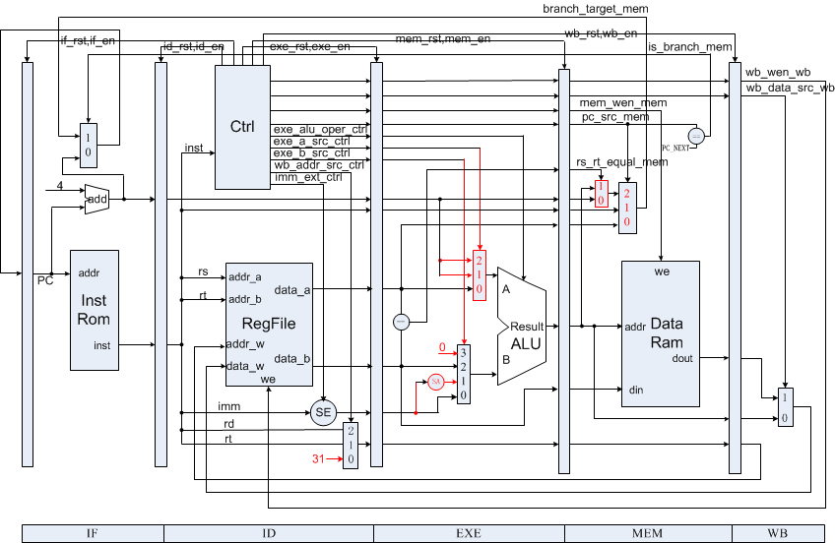
How to Stall the Pipeline

Slide 27
In Which Conditions it Causes Stall(1)
AfromEx ：//ID instr.rs=exe inst.rd and exe instr.writereg
if (rs_used && addr_rs != 0) begin
if (regw_addr_exe == addr_rs && wb_wen_exe) begin
reg_stall = 1;
end
Other expressions：
BfromEx：id instr.rt=ex instr.rd and ex instr.writereg
AfromMem：id instr.rs=mem instr.rd and mem instr.writereg
BfromMem ： id instr.rt=mem instr.rd and mem instr = instr.writereg

Slide 28
In Which Conditions it Causes Stall(2)
When ID Stage for BEQ INSTR.
if (pc_src != PC_NEXT)
branch_stall = 1;
Other expressions：
When EXE Stage for BEQ INSTR.
When MEM Stage for BEQ INSTR.

Slide 29
Project Introduction
Top Module
MIPS Core
Instruction Set
Name
Step Execution principle
Observation Info

Slide 30
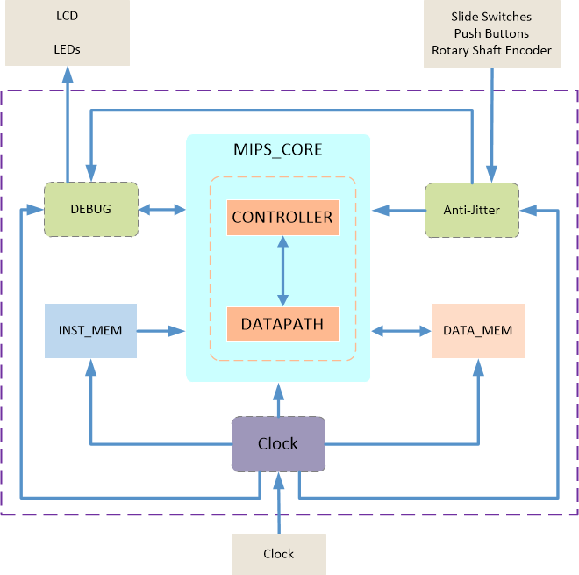
Top Module (1)

Slide 31
Top Module (2)
anti-jitter
clk_gen
debug
mips_core
inst_rom
data_ram
Notes:
Locked = 1，始终稳定的信号

Slide 32
MIPS Core - CPU Controller (1)
CPU Controller works in ID Stage
Set signals according to different instruction

Slide 33
MIPS Core - CPU Controller (1)
No. | singals | comment
1 | inst | Input for id instruction
2 | is_branch_exe | pc src in exe is PC_NEXT or not
3 | regw_addr_exe | address source to write data back to registers
4 | wb_wen_exe | memory write enable signal
5 | is_branch_mem | pc src in mem is PC_NEXT or not
6 | regw_addr_mem | address source to write data back to registers
7 | wb_wen_mem | memory write enable signal
8 | regw_addr_wb | data source of data being written back to registers
9 | wb_wen_wb | register write enable signal
10 | pc_src | pc src: PC_NEXT, PC_JUMP, PC_JR, PC_BEQ

Slide 34
MIPS Core - CPU Controller (2)
No. | singals | comment
11 | imm_ext | If immediate is extended
12 | exe_a_src | Control signal of A operand for ALU
13 | exe_b_src | Control signal of B operand for ALU
14 | exe_alu_oper | ALU operations
15 | mem_ren | Mem read signal
16 | mem_wen | Mem write signal
17 | wb_addr_src | Control signal of write back addr
18 | wb_data_src | Control signal of write back data
19 | wb_wen | Control signal of write back enable

Slide 35
MIPS Core - CPU Controller (3)
No. | singals | comment
21 | if_rst/if_en | Output for if stage controll
22 | if_valid | Input for if stage stage
23 | id_rst/id_en | Output for id stage controll
24 | id_valid | Input for id stage stage
25 | exe_rst/exe_en | Output for exe stage controll
26 | exe_valid | Input for exe stage stage
27 | mem_rst/mem_en | Output for mem stage controll
28 | mem_valid | Input for mem stage stage
29 | wb_rst/wb_en | Output for wb stage controll
30 | wb_valid | Input for wb stage stage

Slide 36
MIPS Core - Datapath
Debug info output
If subModule
Id subModule
Register file
Reg stall logic control
Exe subModule
ALU
Mem subModule
Wb subModule

Slide 37
16 MIPS Instructions
Bit # | 31..26 | 25..21 | 20..16 | 15..11 | 10..6 | 5..0 | Operations
R-type | op | rs | rt | rd | sa | func
add | 000000 | rs | rt | rd | 00000 | 100000 | rd = rs + rt; with overflow | PC+=4
sub |  | rs | rt | rd | 00000 | 100010 | rd = rs - rt; with overflow | PC+=4
and |  | rs | rt | rd | 00000 | 100100 | rd = rs & rt; | PC+=4
or |  | rs | rt | rd | 00000 | 100101 | rd = rs | rt; | PC+=4
sll |  | 00000 | rt | rd | sa | 000000 | rd = rt << sa; | PC+=4
srl |  | 00000 | rt | rd | sa | 000010 | rd = rt >> sa (logical); | PC+=4
slt |  | rs | rt | rd | 00000 | 101010 | if(rs < rt)rd = 1; else rd = 0; <(signed) | PC+=4
jr |  | rs | 00000 | 00000 | 00000 | 001000 |  | PC=rs
I-type | op | rs | rt | immediate
addi | 001000 | rs | rt | imm |  |  | rt = rs + (sign_extend)imm; with overflow | PC+=4
andi | 001100 | rs | rt | imm |  |  | rt = rs & (zero_extend)imm; | PC+=4
ori | 001101 | rs | rt | imm |  |  | rt = rs | (zero_extend)imm; | PC+=4
lw | 100011 | rs | rt | imm |  |  | rt = memory[rs + (sign_extend)imm]; | PC+=4
sw | 101011 | rs | rt | imm |  |  | memory[rs + (sign_extend)imm] <-- rt; | PC+=4
beq | 000100 | rs | rt | imm |  |  | if (rs == rt) PC+=4 + (sign_extend)imm <<2; | PC+=4
J-type | op | address
j | 000010 | address |  |  |  |  | PC = (PC+4)[31..28],address<<2
jal | 000011 | address |  |  |  |  | PC = (PC+4)[31..28],address<<2 ; $31 = PC+4

Slide 38
Name Specification
Signal of
Stage: if, id, exe, mem, wb
Module: ctrl (id)
Signal name
xxx_: works in xxx stage
_xxx: generated from xxx stage

Slide 39
Step Execution Principle
Stall all the stage.
When step button is pushed, unlock the stall controllers of all the stages.
Controller:
else if ((debug_en) && ~(~debug_step_prev && debug_step)) begin
if_en = 0;
id_en = 0;
exe_en = 0;
mem_en = 0;
wb_en = 0;
end

Slide 40
Reg Stall & Branch Stall
// this stall indicate that ID is waiting for previous instruction, insert one NOP between ID and EXE.
else if (reg_stall) begin
if_en = 0;
id_en = 0;
exe_rst = 1;
end
//if branch_stall is on, insert NOP in ID.
else if (branch_stall) begin
id_rst = 1;
end

Slide 41
Observation Info - Input
South Button: Step execution
North Button: Reset
Rotary Shaft Encoder: Index Control
Swtich[0]
0 for register display
1 for data signal display: IF-ADDR/ IF-INST/ ID-ADDR/ ID-INST/ EX-ADDR/ EX-INST/ MM-ADDR/ MM-INST/ EMOPER( mem_ren+ mem_wen)/ MEMADDR/ MEMDATR/ MEMDATW/……
Swtich[3]:
0 for run
1 for step execution

Slide 42
Observation Info - Output
LCD
First line: Hello, world (reserved for Cache display)
Second line: Key + value
LED
display for {buttons , switches}’s states

Slide 43
Program for verification (1)
00000824 main: and $1, $0, $0 # address of data[0]
34240050 ori $4, $1, 80 # address of data[0]
20050004 call: addi $5, $0, 4 # counter
0c00000a jal sum # call function
ac820000 return: sw $2, 0($4) # store result
8c890000 lw $9, 0($4) # check sw
ac890004 sw $9, 4($4) # store result again
01244022 sub $8, $9, $4 # sub: $8 <- $9 - $4
08000008 finish: j finish # dead loop
00000000 nop # done

Slide 44
Program for verification (2)
00004020 sum: add $8, $0, $0 # sum function entry
8c890000 loop: lw $9, 0($4) # load data
01094020 add $8, $8, $9 # sum
20a5ffff addi $5, $5, -1 # counter - 1
20840004 addi $4, $4, 4 # address + 4
0005182a slt $3, $0, $5 # finish?
1460fffa bne $3, $0, loop # finish?
01001025 or $2, $8, $0 # move result to $v0
03e00008 jr $ra # return
00000000 nop # done

Slide 45
Checkpoints
CP 1: Waveform Simulation of 5-stage Pipelined CPU
CP 2: FPGA Implementation of 5-stage Pipelined CPU with the verification program

Slide 46
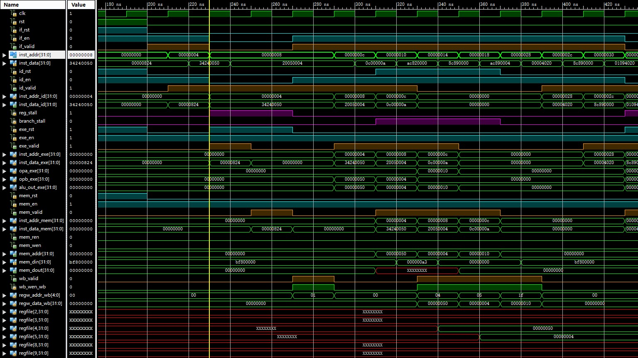
Simulation - 1

Slide 47
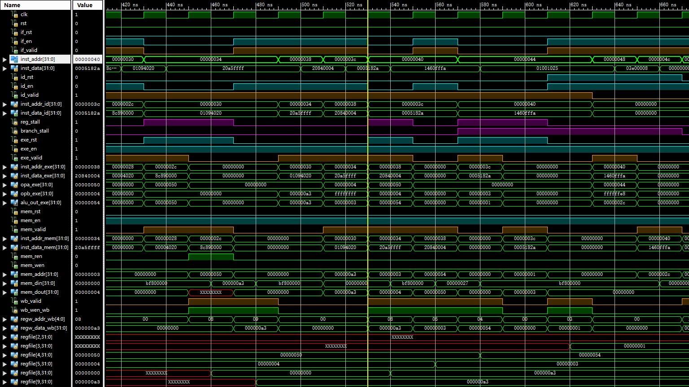
Simulation - 2

Slide 48
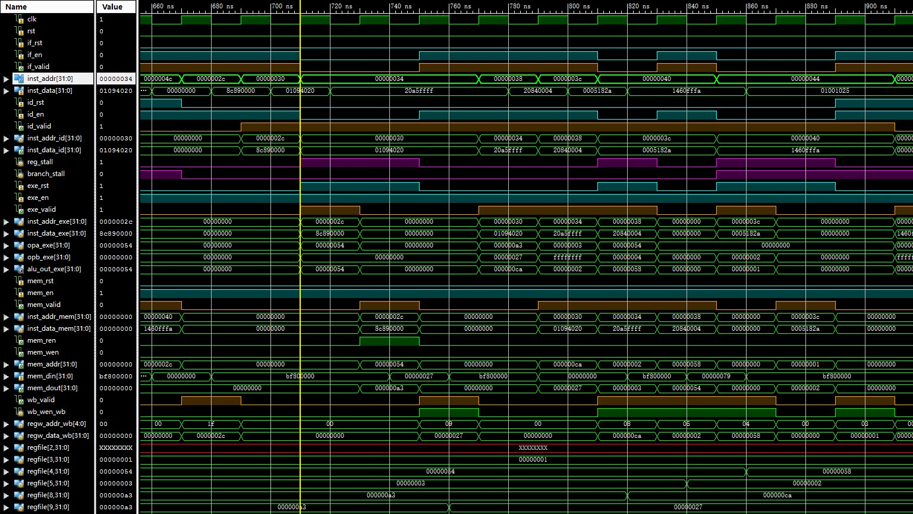
Simulation - 3

Slide 49
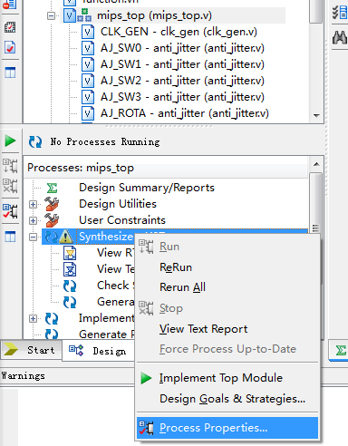
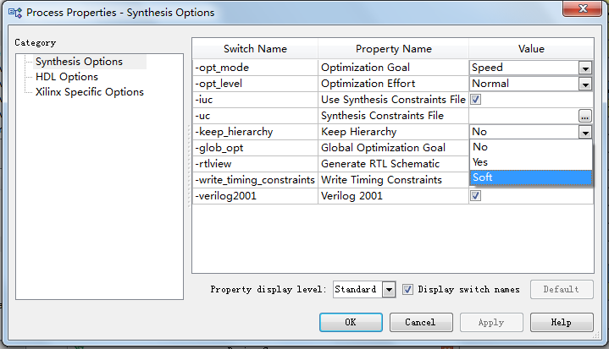
Settings

Slide 50
Thanks!

